Slide 1
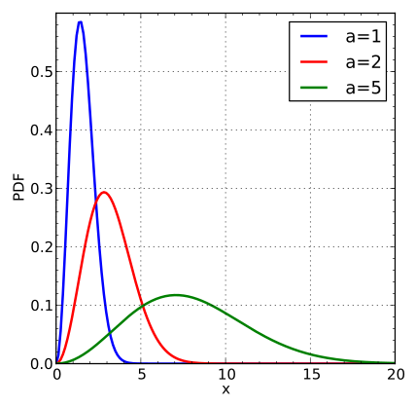
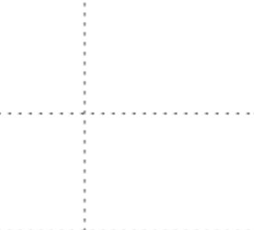
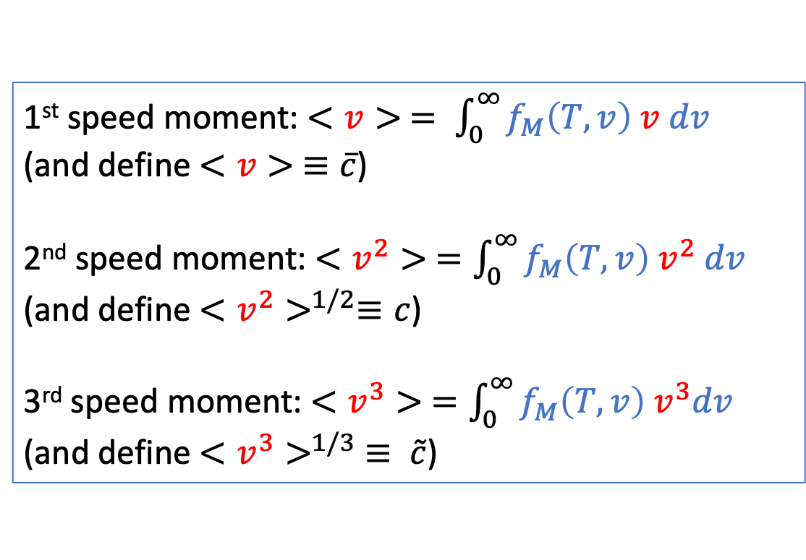

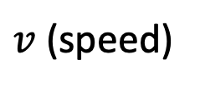
Recap: in the “Moments” CGI, we calculate these quantities numerically
1st speed moment: $<v> = \int_{0}^{∞}{f_{M}\left(T,v\right) v dv}$
(and define $<v> ≡\overline{c}$)
2nd speed moment: $<v^{2}> =\int_{0}^{∞}{f_{M}\left(T,v\right) v^{2} dv}$
(and define $<v^{2}>^{1/2}≡c$)
3rd speed moment: $<v^{3}> =\int_{0}^{∞}{f_{M}\left(T,v\right){ v}^{3}dv}$
(and define $<v^{3}>^{1/3}$ $≡ \tilde{c}$)
$$f_{M}$$
$v$ (speed)

Slide 2





Turns out, they’re ordered (and there’s also a “most probable” speed, $c^{∗}$)
1st speed moment: $<v> = \int_{0}^{∞}{f_{M}\left(T,v\right) v dv}$
(and define $<v> ≡\overline{c}$)
2nd speed moment: $<v^{2}> =\int_{0}^{∞}{f_{M}\left(T,v\right) v^{2} dv}$
(and define $<v^{2}>^{1/2}≡c$)
3rd speed moment: $<v^{3}> =\int_{0}^{∞}{f_{M}\left(T,v\right){ v}^{3}dv}$
(and define $<v^{3}>^{1/3}$ $≡ \tilde{c}$)
$$f_{M}$$
$v$ (speed)
$$c^{∗}$$
$$\overline{c}$$
$$c$$
$$\tilde{c}$$

Slide 3
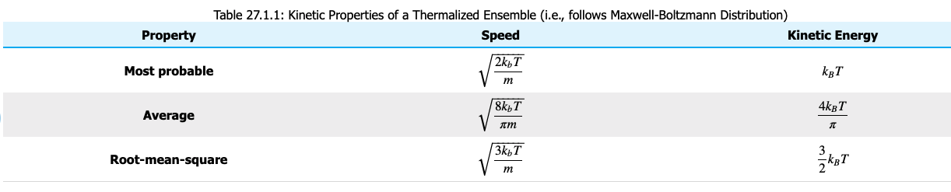



There are also algebraic expressions for these
$$c^{∗}$$
$$f_{M}$$
$$\overline{c}≡ <v>$$
$$c≡ <v^{2}>^{1/2}$$
$v$ (speed)
$$c^{∗}$$
$$\overline{c}$$
$$c$$
$$\tilde{c}$$

Slide 4

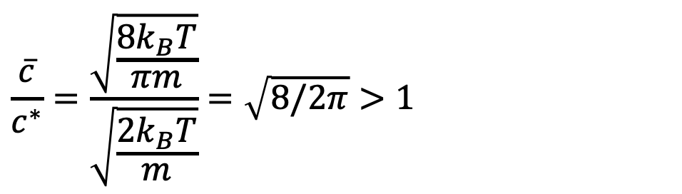
Using our analytical (algebraic) results to demonstrate the ordering
$$c^{∗}$$
$$f_{M}$$
$$\overline{c}≡ <v>$$
$$c≡ <v^{2}>^{1/2}$$
$$\frac{\overline{c}}{c^{∗}}=\frac{\sqrt{\frac{8k_{B}T}{πm}}}{\sqrt{\frac{2k_{B}T}{m}}}=\sqrt{8/2π}>1$$
$v$ (speed)
$$c^{∗}$$
$$\overline{c}$$
$$c$$
$$\tilde{c}$$

Slide 5
Using our analytical (algebraic) results to demonstrate the ordering
$$c^{∗}$$
$$f_{M}$$
$$\overline{c}≡ <v>$$
$$c≡ <v^{2}>^{1/2}$$
$$\frac{\overline{c}}{c^{∗}}=\frac{\sqrt{\frac{8k_{B}T}{πm}}}{\sqrt{\frac{2k_{B}T}{m}}}=\sqrt{8/2π}>1$$
$v$ (speed)
$$c^{∗}$$
$$\overline{c}$$
$$c$$
$$\tilde{c}$$

Slide 6
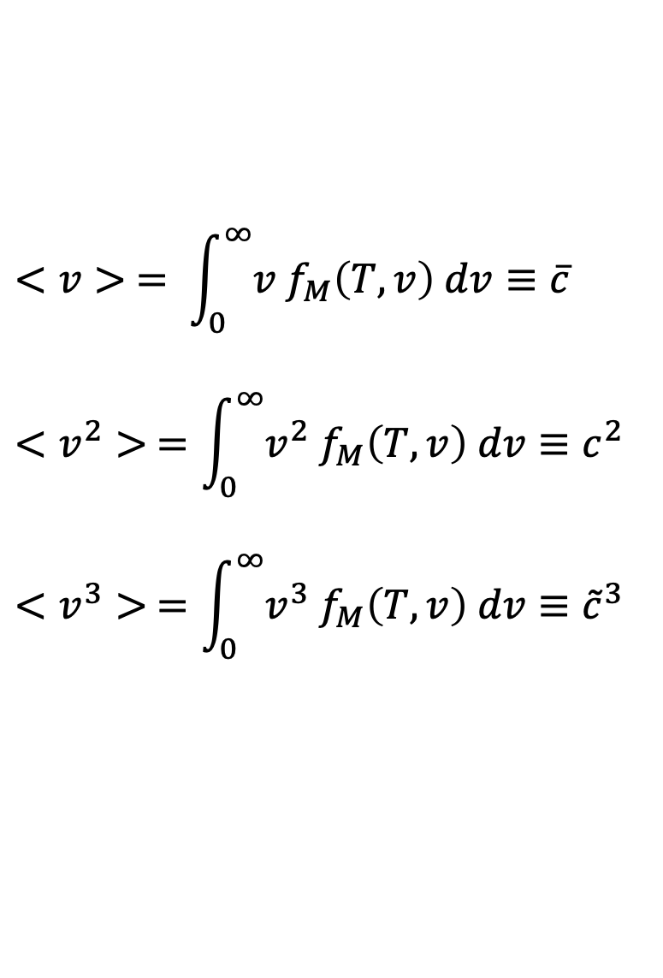
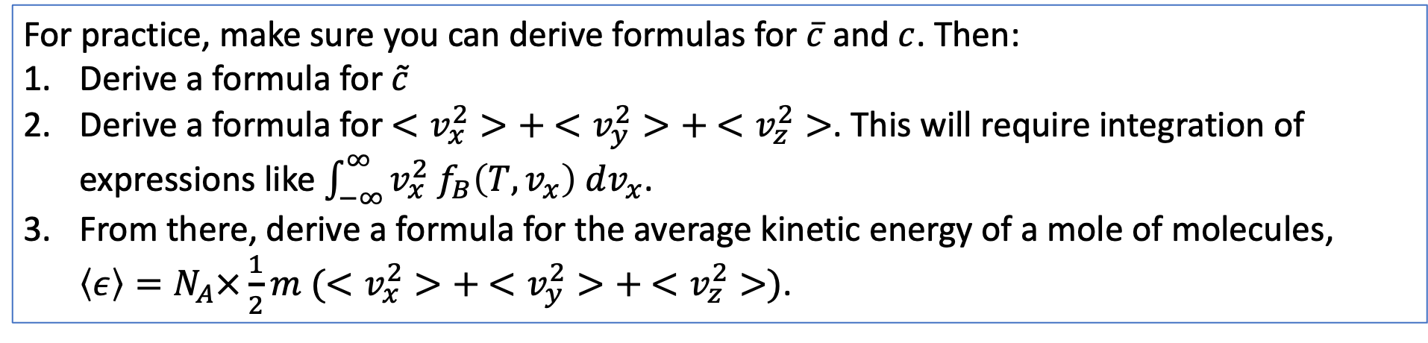
But … where did those analytical results come from?
$$<v> = \int_{0}^{∞}{v f_{M}\left(T,v\right) dv}≡\overline{c}$$
$$<v^{2}> =\int_{0}^{∞}{v^{2} f_{M}\left(T,v\right) dv≡c^{2}}$$
$$<v^{3}> =\int_{0}^{∞}{v^{3} f_{M}\left(T,v\right) dv≡{\tilde{c}}^{3}}$$
For practice, make sure you can derive formulas for $\overline{c}$ and $c$. Then:
Derive a formula for $\tilde{c}$
Derive a formula for $<v_{x}^{2}>+ <v_{y}^{2}>+ <v_{z}^{2}>$. This will require integration of expressions like $\int_{−∞}^{∞}{v_{x}^{2} f_{B}\left(T,v_{x}\right) dv_{x}}$.
From there, derive a formula for the average kinetic energy of a mole of molecules, $\left\langle ε\right\rangle =N_{A}×\frac{1}{2}m (<v_{x}^{2}>+ <v_{y}^{2}>+ <v_{z}^{2}>)\text{.}$

Slide 7
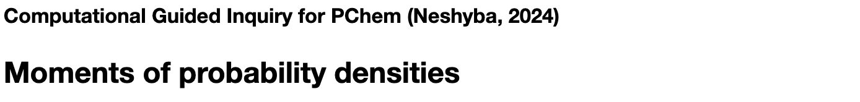

Finishing up the “Moments” CGI

